Slide 1

Operating Systems
Quick Introduction to C Programming Language
Farbod Shahinfar
Iran University of Science and Technology
Fall 2020

Slide 2
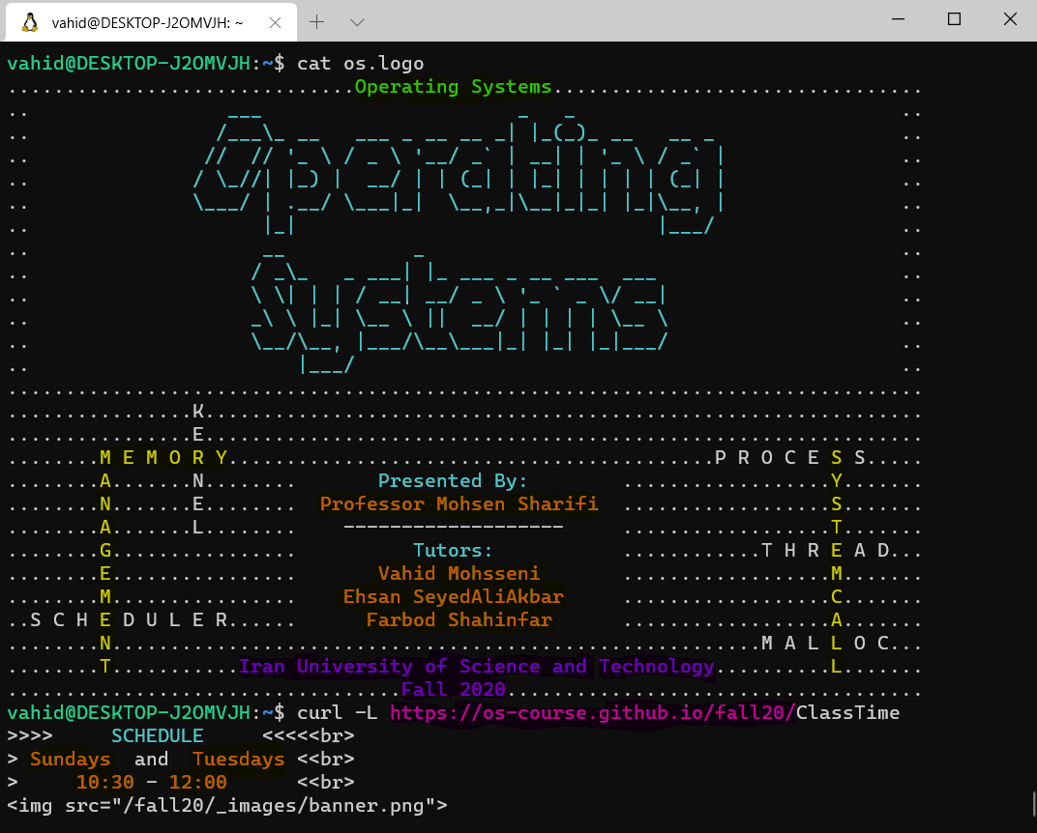

Slide 3
Agenda
Brief History
Structure of a C Program
Data Types
Array
Operators
Flow Control
Functions
Struct and Typedef
Pointers
Memory Allocation
String Processing
Pointer to Functions
Header Files
XV6 Shell
3

Slide 4
Brief History of C Programming Language

Slide 5
History
The C programming language was devised in the early 1970s as a system implementation language for the nascent Unix operating system.
The C programming language was created with the purpose of writing an operating system with a high level language.
3

Slide 6
History
The C programming language was devised in the early 1970s as a system implementation language for the nascent Unix operating system.
The C programming language was created with the purpose of writing an operating system with a high level language.
3

Slide 7
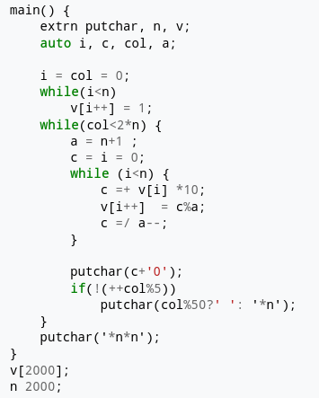
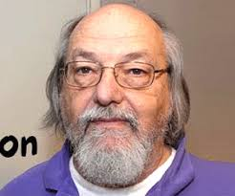
History
Code written in B
C was influenced by B programming language.
B programming language was the developed by Ken Thompson
Ken Thompson
3

Slide 8
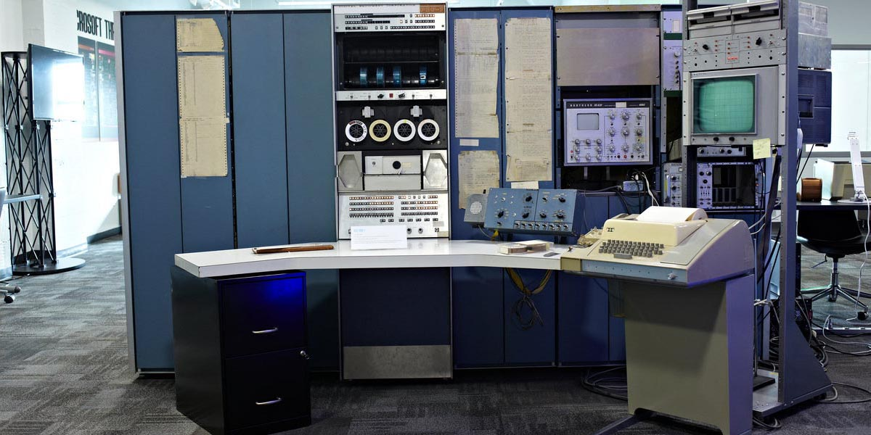
History: PDP-7
Unix was developed for PDP-7 written in assembly by Ritchie and Thompson.
3

Slide 9
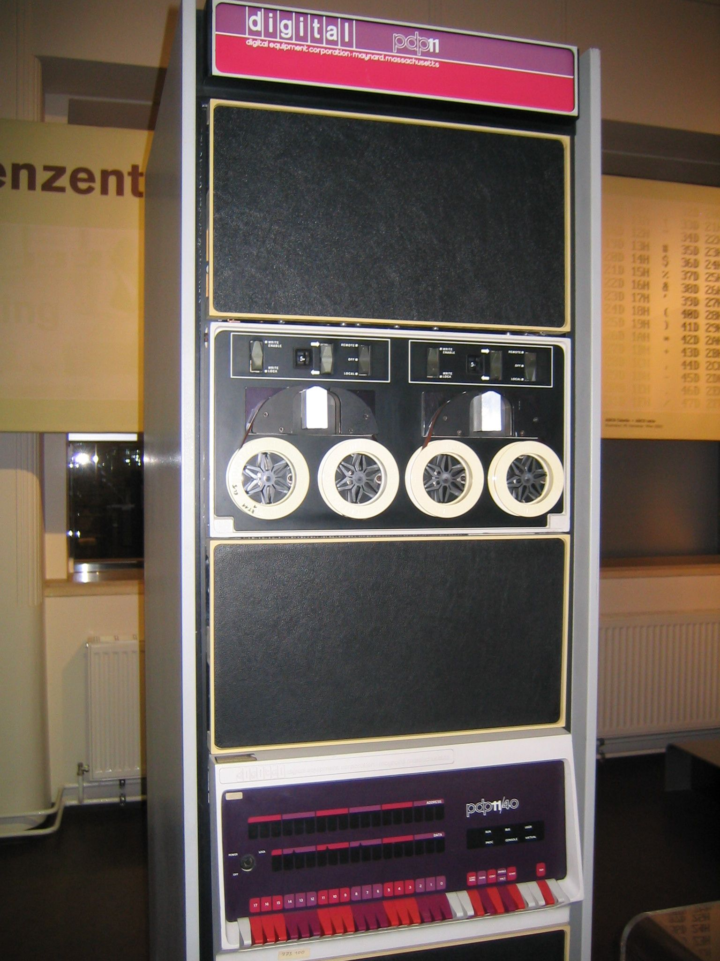
History: PDP-11
Ritchie and Thompson decided to port UNIX on PDP-11
UNIX for PDP-11 was also developed in assembly
There was need for a programming language for developing utilities on the new platform
3

Slide 10
History: PDP-11
Try to implement Fortran compiler
Try to use BCPL which resulted in B
B was slow and not taking advantage of hardware capabilities.
Dennis Ritchie created C (1972)
3

Slide 11
History
Unix v2, had C compiler and related utility
Unix v4 was re-implemented with C.
Unix was one of the first operating system kernels to be implemented in a language other than assembly.
3

Slide 12

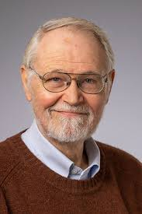
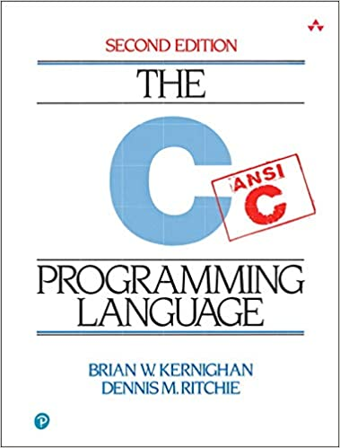
History: CD&K
Dennis Ritchie
1941 – 2011
Known for:
ALTRAN
B
BCPL
C
Multics
Unix
Brian W. Kernighan
1942 – present
Known for:
Unix
AWK
Kernighan–Lin algorithm
The C programming book
3

Slide 13
History
During 1970 and 1980 versions of C was implemented for different types of computers so there was a need for a standard definition.
Since then ANSI and then ISO have voted on different C standards including: C89, C99, C11, C18
3

Slide 14
Compiled or Interpreted

Slide 15
Structure of a C Program

Slide 16
Structure of a C Program
/* adding standard input output header file to the
* source code.
* */
#include <stdio.h>
int main(int argc, char *argv[])
{
// defining some variables
int a;
int b, c;
a = 10;
b = 20;
c = a + b;
// writing to stdout
printf("hello world\n");
printf("a + b = %d\n", c);
return 0;
}
3

Slide 17
Structure of a C Program
/* adding standard input output header file to the
* source code.
* */
#include <stdio.h>
int main(int argc, char *argv[])
{
// defining some variables
int a;
int b, c;
a = 10;
b = 20;
c = a + b;
// writing to stdout
printf("hello world\n");
printf("a + b = %d\n", c);
return 0;
}
Commenting, multiline and single line
3

Slide 18
Structure of a C Program
/* adding standard input output header file to the
* source code.
* */
#include <stdio.h>
int main(int argc, char *argv[])
{
// defining some variables
int a;
int b, c;
a = 10;
b = 20;
c = a + b;
// writing to stdout
printf("hello world\n");
printf("a + b = %d\n", c);
return 0;
}
Adding header file to the source code.
#include <….> // search in the systems directories
#include “……” // can have relative path
(more on the topic of header file in future.)
3

Slide 19
Structure of a C Program
/* adding standard input output header file to the
* source code.
* */
#include <stdio.h>
int main(int argc, char *argv[])
{
// defining some variables
int a;
int b, c;
a = 10;
b = 20;
c = a + b;
// writing to stdout
printf("hello world\n");
printf("a + b = %d\n", c);
return 0;
}
By convention the program starts from the main function.
The main function can have two variables
Int argc and char *argv[].
With help of these variable you can access the parameters passed to the program with they are called.
3

Slide 20
Structure of a C Program
/* adding standard input output header file to the
* source code.
* */
#include <stdio.h>
int main(int argc, char *argv[])
{
// defining some variables
int a;
int b, c;
a = 10;
b = 20;
c = a + b;
// writing to stdout
printf("hello world\n");
printf("a + b = %d\n", c);
return 0;
}
A block of code is defined by { } in the C programming language.
This block determines the scope of function, variables and other statements.
3

Slide 21
Structure of a C Program
/* adding standard input output header file to the
* source code.
* */
#include <stdio.h>
int main(int argc, char *argv[])
{
// defining some variables
int a;
int b, c;
a = 10;
b = 20;
c = a + b;
// writing to stdout
printf("hello world\n");
printf("a + b = %d\n", c);
return 0;
}
Variable definition
<type> <variable name> [,<variable name>];
3

Slide 22
Data Types

Slide 23
Data Types
Name | Size (bytes)
[unsigned] char | 1
[unsigned] short | 2
[unsigned] int | 4
[unsigned] long | 8
[unsigned] long long | 8
[unsigned] float | 4
[unsigned] double | 8
Size of data types may vary depending on compiler and its configurations.
No boolean type but: #include <stdboo.h> defines bool, true, and false.
3

Slide 24
Data Types
Notice, in <stdint.h> there are some useful type definitions.
int8_t, int16_t, int32_t, int64_t
uint8_t, uint16_t, uint32_t, uin64_t
Link: https://www.gnu.org/software/libc/manual/html_node/Integers.html
3

Slide 25
Data Types
Signed
Unsigned
bit: 3 2 1 0
[ 0 ][ 0 ][ 0 ][ 0 ] = 0
[ 0 ][ 0 ][ 0 ][ 1 ] = 1
[ 0 ][ 0 ][ 1 ][ 0 ] = 2
[ 0 ][ 0 ][ 1 ][ 1 ] = 3
[ 0 ][ 1 ][ 0 ][ 0 ] = 4
.
.
.
[ 0 ][ 1 ][ 1 ][ 1 ] = 7
[ 1 ][ 0 ][ 0 ][ 0 ] = -8
[ 1 ][ 0 ][ 0 ][ 1 ] = -7
[ 1 ][ 0 ][ 1 ][ 0 ] = -6
[ 1 ][ 0 ][ 1 ][ 1 ] = -5
[ 1 ][ 1 ][ 0 ][ 0 ] = -4
.
.
.
bit: 3 2 1 0
[ 0 ][ 0 ][ 0 ][ 0 ] = 0
[ 0 ][ 0 ][ 0 ][ 1 ] = 1
[ 0 ][ 0 ][ 1 ][ 0 ] = 2
[ 0 ][ 0 ][ 1 ][ 1 ] = 3
[ 0 ][ 1 ][ 0 ][ 0 ] = 4
.
.
.
[ 0 ][ 1 ][ 1 ][ 1 ] = 7
[ 1 ][ 0 ][ 0 ][ 0 ] = 8
[ 1 ][ 0 ][ 0 ][ 1 ] = 9
[ 1 ][ 0 ][ 1 ][ 0 ] = 10
[ 1 ][ 0 ][ 1 ][ 1 ] = 11
[ 1 ][ 1 ][ 0 ][ 0 ] = 12
.
.
.
3

Slide 26
Operators
3

Slide 27
Operators
Type | Operators
Arithmetic | *, /, +, -, %, ++, --
Relational | ==, !=, >, <, >=, <=
Logical | &&, ||, !
Bitwise | &, |, ^, ~, <<, >>
Assign | =, <arithmetic op>=, <bitwise op>=
Others | sizeof(), &, *, (condition) ? <value> : <value>
Sizeof returns the number of bytes a data type requires.
3

Slide 28
Array

Slide 29
Array
#include <stdio.h>
int main(int argc, char *argv[])
{
int values[] = {1,2,3,4};
// int values[10] = {1,2,3,4}; // what is the difference?
printf(“values[2]: %d\n”, values[2]);
Int arr2d[4][5] = {
{1,2,3,4},
{5,6,7,8},
{9,0,1,2}
};
return 0;
}
You can access values in the array by using its index counting from 0.
Initialization will start from index 0 and assigns values.
Unspecified indexes are set to 0.
3

Slide 30
Array
Sizeof an array variable evaluates to the amount of memory array has acquired.
3

Slide 31
Array: Declaring an Array
{
int i, j, intArray[ 10 ], number;
float floatArray[ 1000 ];
int tableArray[ 3 ][ 5 ]; /* 3 rows by 5 columns */
const int NROWS = 100;
const int NCOLS = 200;
float matrix[ NROWS ][ NCOLS ];
}
3

Slide 32
Array: Initializing Array
{
int i = 5, intArray[ 6 ] = { 1, 2, 3, 4, 5, 6 }, k;
float sum = 0.0f,
floatArray[ 100 ] = { 1.0f, 5.0f, 20.0f };
double piFractions[ ] = {3.141592654,
1.570796327, 0.785398163};
int numbers[100] = {1, 2, 3, [10] = 10, 11, 12,
[60] = 50, [42] = 420 };
};
3

Slide 33
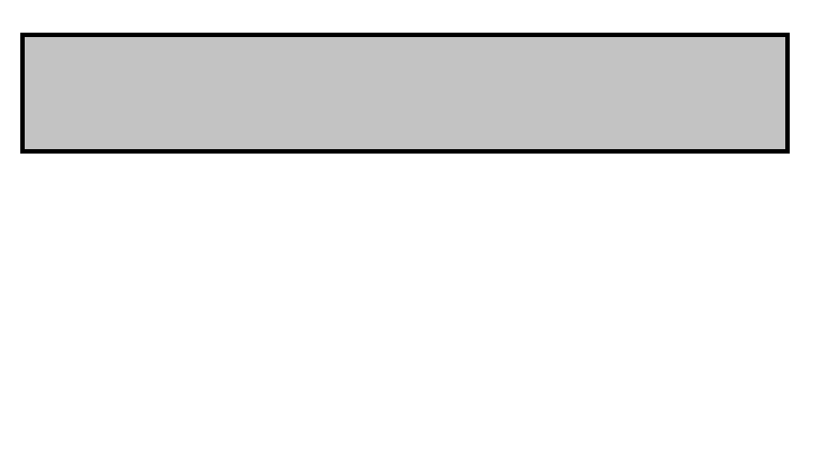
Array
int arr[count];
arr
0
sizeof(int) x count
3

Slide 34
Array
int arr[count];
arr + 1
arr + 2
…
arr + n
arr
0
sizeof(int) x count
3

Slide 35
Array: 2d Array memory layout
char mat[row][col]; // row = 3, col = 5
0
row x col x sizeof(char)
* sizeof(char) = 1 Byte
* C supports row-major arrays
3

Slide 36
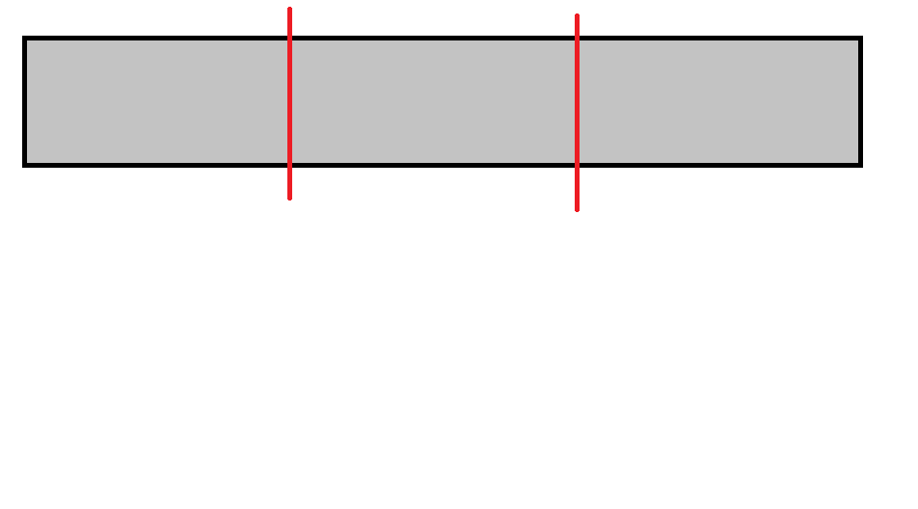
Array: 2d Array memory layout
char mat[row][col]; // row = 3, col = 5
0
col x sizeof(char)
2 x col x sizeof(char)
row x col x sizeof(char)
* sizeof(char) = 1 Byte
* C supports row-major arrays
3

Slide 37
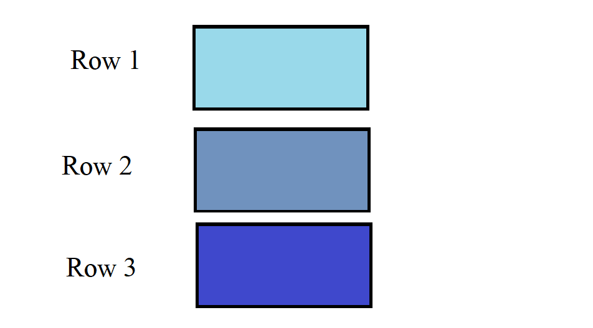
Array: 2d Array memory layout
char mat[row][col]; // row = 3, col = 5
0
col
col
2 x col
2 x col
row x col
3

Slide 38
Array: 2d Array memory layout
char mat[row][col]; // row = 3, col = 5
row 0: 0x…020 0x…021 0x…022 0x…023 0x…024
row 1: 0x…025 0x…026 0x…027 0x…028 0x…029
row 2: 0x…02a 0x…02b 0x…02c 0x…02d 0x…02e
3

Slide 39
Flow Control

Slide 40
Flow Control: If Statements
#include <stdio.h>
int main(int argc, char *argv[])
{
int temperature;
scanf(“%d\n”, &temperature);
if (temperature < 23) {
turn_on_heater();
} else if (temperature < 26) {
turn_off_heater();
turn_off_cooler();
} else if (temperature < 40) {
if (is_heater_enable()) {
turn_off_heater();
}
turn_on_cooler();
}
return 0;
}
3

Slide 41
Flow Control: While Statements
#include <stdio.h>
#include <string.h>
int main(int argc, char *argv[])
{
unsigned char condition = 1;
char cmd[32];
while (condition) {
fgets(cmd, 32, stdin);
if (strcmp(cmd, "quit\n") == 0) {
condition = 0;
}
/* execute the command and perform
* related operations.
* ...
*/
}
return 0;
}
3

Slide 42
Flow Control: Do-While Statements
#include <stdio.h>
#include <string.h>
int main(int argc, char *argv[])
{
unsigned char condition = 1;
do {
/* do operations and related logic
* ...
*/
} while (condition);
return 0;
}
3

Slide 43
Flow Control: For loop
#include <stdio.h>
int main(int argc, char *argv[])
{
int count = 8;
for (int i = 0; i < count; i++) {
// ...
}
return 0;
}
3

Slide 44
Flow Control: For loop equivalent While loop
#include <stdio.h>
int main(int argc, char *argv[])
{
/*for (int i = 0; i < count; i++) {
}*/
int count = 8;
int i = 0;
while (i < count) {
// …
// last instruction
i++;
}
return 0;
}
3

Slide 45
Flow Control: For loop, Fibonacci Sequence
/* Program to calculate the first 20 Fibonacci numbers. */
#include <stdlib.h>
#include <stdio.h>
int main(void)
{
int i, fibonacci[ 20 ];
fibonacci[ 0 ] = 0; fibonacci[ 1 ] = 1;
for( i = 2; i < 20; i++ )
fibonacci[ i ] = fibonacci[ i - 2 ] + fibonacci[ i - 1 ];
for( i = 0; i < 20; i++ )
printf( "Fibonacci[ %d ] = %f\n", i, fibonacci[ i ] );
}
3

Slide 46
Flow Control: Break and Continue
#include <stdio.h>
int main(int argc, char *argv[]) {
unsigned char condition = 1;
int array[] = {5, 6, 2, 8, 12, 19, 20, 13};
int count = 8;
int key = 19;
int index = -1;
int count_odd = 0;
for (int i = 0; i < count; i++) {
if (array[i] == key) {
index = i;
break;
}
if (array[i] % 2 == 0)
continue;
count_odd++;
}
return 0;
}
3

Slide 47
Flow Control: Switch-Case
#include <stdio.h>
int main(int argc, char *argv[])
{
unsigned char condition = 1;
switch (value) {
case 1:
// ….
break;
case 2:
case 3:
// ….
break;
default:
//….
}
return 0;
}
3

Slide 48
Functions

Slide 49
Functions
#include <stdio.h>
#include <stdbool.h>
bool is_even(int value){
return value % 2 == 0;
}
int main(int argc, char *argv[])
{
int val;
scanf(“%d\n”, &val);
if (is_even(val)) {
printf(“it is even\n”);
} else {
printf(“it is odd\n”);
}
return 0;
}
3

Slide 50
Functions
#include <stdio.h>
void divide_by_2(int arr[], int size){
// pass by reference
for (int I = 0; I < size; I++) {
arr[I] = arr[I] / 2;
}
}
int main(int argc, char *argv[])
{
int val;
scanf(“%d\n”, &val);
if (is_even(val)) {
printf(“it is even\n”);
} else {
printf(“it is odd\n”);
}
return 0;
}
3

Slide 51
Functions: Trace a function call
#include <stdio.h>
void func(int a){
int b = 10;
return a / b;
}
int main(int argc, char *argv[])
{
int val;
int c;
scanf(“%d\n”, &val);
c = func(val);
printf(“%d\n” c);
return 0;
}
Address | Value
0x00A1 | ….
0x00A2 | ….
0x00A3 | ….
0x00A4 | ….
0x00A5 | ….
0x00A6 | ….
0x00A7 | ….
0x00A8 | …..
0x00A9 | ….
3

Slide 52
Functions: Trace a function call
#include <stdio.h>
void func(int a){
int b = 10;
return a / b;
}
int main(int argc, char *argv[])
{
int val;
int c;
scanf(“%d\n”, &val);
c = func(val);
printf(“%d\n” c);
return 0;
}
Address | Value
0x00A1 | ….
0x00A2 | ….
0x00A3 | ….
0x00A4 | ….
0x00A5 | ….
0x00A6 | ….
0x00A7 | ….
0x00A8 | …..
0x00A9 | ….
int val
int c
3

Slide 53
Functions: Trace a function call
#include <stdio.h>
void func(int a){
int b = 10;
return a / b;
}
int main(int argc, char *argv[])
{
int val;
int c;
scanf(“%d\n”, &val);
c = func(val);
printf(“%d\n” c);
return 0;
}
Address | Value
0x00A1 | ….
0x00A2 | ….
0x00A3 | ….
0x00A4 | ….
0x00A5 | ….
0x00A6 | ….
0x00A7 | ….
0x00A8 | …..
0x00A9 | ….
int val
int c
3

Slide 54
Functions: Trace a function call
#include <stdio.h>
void func(int a){
int b = 10;
return a / b;
}
int main(int argc, char *argv[])
{
int val;
int c;
scanf(“%d\n”, &val);
c = func(val);
printf(“%d\n” c);
return 0;
}
Address | Value
0x00A1 | 25
0x00A2 | ….
0x00A3 | ….
0x00A4 | ….
0x00A5 | ….
0x00A6 | ….
0x00A7 | ….
0x00A8 | …..
0x00A9 | ….
int value
int c
3

Slide 55
Functions: Trace a function call
#include <stdio.h>
void func(int a){
int b = 10;
return a / b;
}
int main(int argc, char *argv[])
{
int val;
int c;
scanf(“%d\n”, &val);
c = func(val);
printf(“%d\n” c);
return 0;
}
Address | Value
0x00A1 | 25
0x00A2 | ….
0x00A3 | ….
0x00A4 | ….
0x00A5 | ….
0x00A6 | ….
0x00A7 | ….
0x00A8 | …..
0x00A9 | ….
int value
int c
int a
int b
3

Slide 56
Functions: Trace a function call
#include <stdio.h>
void func(int a){
int b = 10;
return a / b;
}
int main(int argc, char *argv[])
{
int val;
int c;
scanf(“%d\n”, &val);
c = func(val);
printf(“%d\n” c);
return 0;
}
Address | Value
0x00A1 | 25
0x00A2 | ….
0x00A3 | ….
0x00A4 | ….
0x00A5 | 25
0x00A6 | 10
0x00A7 | ….
0x00A8 | …..
0x00A9 | ….
int value
int c
int a
int b
Return register
2
3

Slide 57
Functions: Trace a function call
#include <stdio.h>
void func(int a){
int b = 10;
return a / b;
}
int main(int argc, char *argv[])
{
int val;
int c;
scanf(“%d\n”, &val);
c = func(val);
printf(“%d\n” c);
return 0;
}
Address | Value
0x00A1 | 25
0x00A2 | ….
0x00A3 | ….
0x00A4 | ….
0x00A5 | 25
0x00A6 | 10
0x00A7 | ….
0x00A8 | …..
0x00A9 | ….
int value
int c
int a
int b
Return register
2
3

Slide 58
Functions: Trace a function call
#include <stdio.h>
void func(int a){
int b = 10;
return a / b;
}
int main(int argc, char *argv[])
{
int val;
int c;
scanf(“%d\n”, &val);
c = func(val);
printf(“%d\n” c);
return 0;
}
Address | Value
0x00A1 | 25
0x00A2 | 2
0x00A3 | ….
0x00A4 | ….
0x00A5 | 25
0x00A6 | 10
0x00A7 | ….
0x00A8 | …..
0x00A9 | ….
int value
int c
Return register
2
3

Slide 59
Struct and Typedef

Slide 60
Struct and Typedef
#include <stdio.h>
struct point {
Int x;
Int y;
};
typedef struct point point_t;
void print_point(struct point p) {
printf(“(%d, %d)\n”, p.x, p.y);
}
int main(int argc, char *argv[])
{
point_t p1 = {.x=5, .y=2};
print_point(p1);
return 0;
}
You can define a structure to store values in a certain way.
You can define a name for the struct.
This is may be good for code readability and creating abstractions.
3

Slide 61
Struct and Typedef
struct obj_state {
uint8_t id;
uint8_t running;
float prio;
char *name[10];
};
int main()
{
struct obj_state state1;
return 0;
}
Address | Value
0x00A1 | 10
0x00A2 | 120
0x00A3 | ….
0x00A4 | ….
0x00A5 | 25
0x00A6 | 10
0x00A7 | 0x00BC
0x00A8 | …..
0x00A9 | ….
id
state1
running
prio
name
3

Slide 62
Struct and Typedef
Fields of a struct may not be contiguous because compiler may add padding for performance purposes.
Address | Value
0x00A1 | 10
0x00A2 | 120
0x00A3 | ….
0x00A4 | ….
0x00A5 | 25
0x00A6 | 10
0x00A7 | 0x00BC
0x00A8 | …..
0x00A9 | ….
Char
Char
struct begin address: 0x…150
a: 0x…150 (expected: 0x…150)
b: 0x…151 (expected: 0x…151)
c: 0x…154 (expected: 0x…152)
d: 0x…158 (expected: 0x…156)
struct {
char a,
char b,
int c,
char d
};
Padding
Int (4bytes)
Char
3

Slide 63
Struct and Typedef
It is possible to give instructions to compiler not to add padding
For GCC __attribute__((__packed__))
Address | Value
0x00A1 | 10
0x00A2 | 120
0x00A3 | ….
0x00A4 | ….
0x00A5 | 25
0x00A6 | 10
0x00A7 | 0x00BC
0x00A8 | …..
0x00A9 | ….
Char
Char
struct begin address: 0x…9c0
a: 0x…9c0 (expected: 0x…9c0)
b: 0x…9c1 (expected: 0x…9c1)
c: 0x…9c2 (expected: 0x…9c2)
d: 0x…9c6 (expected: 0x…9c6)
Int (4bytes)
Char
3

Slide 64
Pointers

Slide 65
Pointers
#include <stdio.h>
int main(int argc, char *argv[])
{
int value = 10;
int *p;
p = &value;
printf(“value is: %d, “
”(address: %x)\n”,
*p, p);
return 0;
}
Address | Value
0x00A1 | ….
0x00A2 | 10
0x00A3 | ….
0x00A4 | ….
0x00A5 | ….
0x00A6 | ….
0x00A7 | ….
0x00A8 | 0x00A2
0x00A9 | ….
int value
int *p
3

Slide 66
Pointers
#include <stdio.h>
struct rectangle { int width; int height; point_t top_left;};
void print_rect(struct rectangle *p) {
printf(“<w: %d, h: %d, x: %d, y: %d>\n”,
p->width, p->height, p->top_left.x,
p->top_left.y);
}
int main(int argc, char *argv[]) {
point_t p1 = {.x=2, .y=-3};
struct rectangle r1 = {.width=10, .height=5, top_left=p1};
print_rect(&r1);
return 0;
}
Pass the address of the structure to the function.
Reduces memory copy.
3

Slide 67
Pointers
#include <stdio.h>
struct rectangle { int width; int height; point_t top_left;};
void print_rect(struct rectangle *p) {
printf(“<w: %d, h: %d, x: %d, y: %d>\n”,
p->width, p->height, p->top_left.x,
p->top_left.y);
}
int main(int argc, char *argv[]) {
point_t p1 = {.x=2, .y=-3};
struct rectangle r1 = {.width=10, .height=5, top_left=p1};
print_rect(&r1);
return 0;
}
p->top_left.x
(*p).top_left.x
get the struct from address pointed to by `p` and select `top_left` member of the struct.
3

Slide 68
Pointers
Both instructions below are equivalent:
p→width = 10;
(*p).width = 10;
3

Slide 69
Pointers: Arithmetic
When incrementing a pointer the address is changed with respect to the size of data type of the pointer.
{
int64_t val = 10;
int64_t *p64 = &val;
printf(“p64:%x,%x\n”, p64, p64+1);
int8_t *p8 = (int8_t *)(&val);
printf(“p8: %x, %x\n”, p8, p8+1);
return 0;
}
P8 moved 1 byte
P64 moved 8 bytes
p64, p64+1: 4a7d3c60, 4a7d3c68
p8, p8+1: 4a7d3c60, 4a7d3c61
3

Slide 70
Pointers: sizeof()
Size of an pointer is the address size:
On a 32 bit system sizeof(*p) == 4
On a 64 bit system sizeof(*p) == 8
3

Slide 71
Memory Allocation

Slide 72
Memory Allocation
Local variables are allocated from stack memory.
Local variables are freed when they are out of scope (for example function return)
Allocating memory with `malloc` or `calloc` uses heap memory.
Memory should be explicitly freed using `free` function.
3

Slide 73
Memory Allocation
#include <stdio.h>
struct rectangle { int width; int height; point_t top_left;};
struct rectangle new_rect(int w, int h) {
struct rectangle rect;
rect.width = w;
rect.hight = h;
return rect;
}
int main(int argc, char *argv[])
{
struct rectangle rect = new_rect(10, 5);
// do some processing
free(rect);
return 0;
}
Danger: On return the rect data structure is copied.
3

Slide 74
Memory Allocation
#include <stdio.h>
struct rectangle { int width; int height; point_t top_left;};
struct rectangle *new_rect(int w, int h) {
struct rectangle rect;
rect.width = w;
rect.hight = h;
return &rect;
}
int main(int argc, char *argv[])
{
struct rectangle *rect = new_rect(10, 5);
// do some processing
free(rect);
return 0;
}
Danger: On return the context of the function is destroyed and, the returned pointer is invalid
3

Slide 75
Memory Allocation
#include <stdio.h>
struct rectangle { int width; int height; point_t top_left;};
struct rectangle *new_rect(int w, int h) {
struct rectangle *rect = \
malloc(sizeof(struct rectangle *));
rect→width = w;
rect→hight = h;
return rect;
}
int main(int argc, char *argv[])
{
struct rectangle *rect = new_rect(10, 5);
// do some processing
free(rect);
return 0;
}
Allocate memory from heap
3

Slide 76
Pointers Revisited

Slide 77
Pointers Revisited: Pointer to Pointer
void new_rect(struct rectangle **p) {
struct rectangle *r;
r = malloc(sizeof(struct rectangle));
*r = (struct rec..) {
.width = 1,
.height = 2,
.top_left = (point_t) {.x=3, .y=4},
};
*p = r;
}
int main(int argc, char *argv[]) {
struct rectangle *r1 = NULL;
new_rect(&r1);
print_rect(&r1);
return 0;
}
3

Slide 78
Pointers Revisited: Allocate array from heap
int main(int argc, char *argv[]) {
float *arr;
arr = malloc( 1000 * sizeof(*arr));
for (int i = 0; i < 1000; i++)
arr[i] = 3.14;
return 0;
}
Memory allocated from heap
0
1000 x sizeof(float)
arr
3

Slide 79
Pointers Revisited: Allocate 2d arrays
int main(int argc, char *argv[]) {
// mat [50][1000]
float **arr;
arr = malloc ( 50 * sizeof(float *));
for (int i = 0; i < 50; i++)
arr[i] = malloc( 1000 * sizeof(float));
for (int i = 0; i < 50; i++)
for (int j = 0; j < 1000; j++)
arr[i][j] = 3.14;
return 0;
}
3

Slide 80
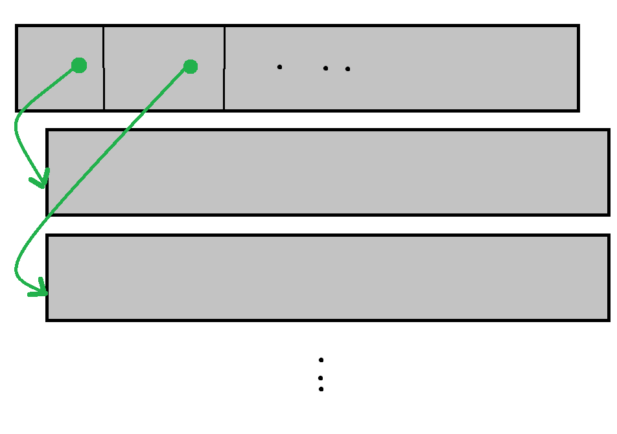
Pointers Revisited: Allocate 2d arrays
int main(int argc, char *argv[]) {
// mat [50][1000]
float **arr;
arr = malloc ( 50 * sizeof(float *));
for (int i = 0; i < 50; i++)
arr[i] = malloc( 1000 *
sizeof(float));
Allocated array of pointers
Allocated memory of size (1000 * sizeof (float)
Allocated memory of size (1000 * sizeof (float)
3

Slide 81
String Processing

Slide 82
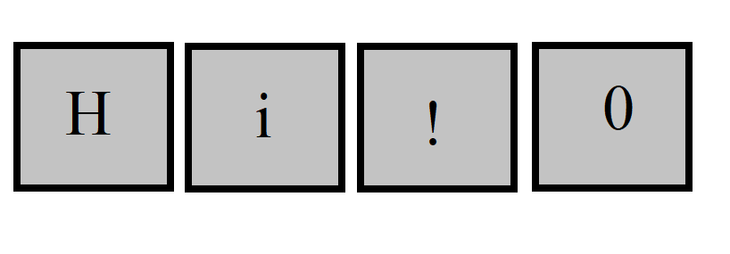
String Processing
Strings are an array of characters
char str[100];
char *str = malloc(….);
The end of string is usually determined by ‘\0’
It is called null-terminated string
3

Slide 83
String Processing
\n
\r
\t
\0
3

Slide 84
String Processing
Header file <string.h>
size_t strlen(const char *s);
size_t strnlen(const char *s, size_t maxlen);
3

Slide 85
String Processing
Header file <string.h>
char *strcpy(char *dest, const char *src);
char *strncpy(char *dest, const char *src, size_t n);
3

Slide 86
String Processing
Header file <stdlib.h>
int atoi(const char *nptr);
long atol(const char *nptr);
long long atoll(const char *nptr);
3

Slide 87
String Processing
Header file <stdio.h>
int scanf(const char *format, ...);
int sscanf(const char *str, const char *format, ...);
3

Slide 88
String Processing
Header file <stdio.h>
int printf(const char *format, ...);
int sprintf(char *str, const char *format, ...);
int snprintf(char *str, size_t size, const char *format, ...);
3

Slide 89
String Processing
%d: integer
%ld: long
%s: string
%x: hex
%p: pointer
3

Slide 90
Pointer to Function

Slide 91
Pointer to Function
To define a variable having type of pointer to a function:
<function return type> (*<variable name>)(<list of input parameters>)
int (*count_even)(int arr[], int count)
typedef can be used to define a type and create abstraction
3

Slide 92
Pointer to Function
typedef int(*on_btn_clk_t)(struct event*);
int my_func(struct *event) {
// …
return 0;
}
int main(void)
{
on_btn_clk_t _func = &my_func;
// …
if (condition) {
_func(ev);
}
exit();
}
3

Slide 93
Header Files

Slide 94
XV6 Shell

Slide 95
XV6 Shell
XV6 is a UNIX like operating system implemented for educational purposes by MIT students.
Last session we examined how an operating system boots. In this section we assume that operating system has been booted and the kernel is ready. We focus on the shell program letting users to interact with the system.
3

Slide 96
XV6 Shell
int
main(void)
{
// ….
exit();
}
By convention starts from main function.
3

Slide 97
XV6 Shell
int
main(void)
{
static char buf[100];
int fd;
// Ensure that three file descriptors are open.
while((fd = open("console", O_RDWR)) >= 0){
if(fd >= 3){
close(fd);
break;
}
}
// ….
exit();
}
Make sure at least three file descriptors are open
0: stdin
1: stdout
2: stderr
3

Slide 98
XV6 Shell
int
main(void)
{
static char buf[100];
int fd;
// ….
while(getcmd(buf, sizeof(buf)) >= 0){
if(buf[0] == 'c' && buf[1] == 'd' && buf[2] == ' '){
// Chdir must be called by the parent, not the child.
buf[strlen(buf)-1] = 0; // chop \n
if(chdir(buf+3) < 0)
printf(2, "cannot cd %s\n", buf+3);
continue;
}
if(fork1() == 0)
runcmd(parsecmd(buf));
wait();
}
exit();
}
Read a command and execute…
<number>

Slide 99
XV6 Shell
int
getcmd(char *buf, int nbuf)
{
printf(2, "$ ");
memset(buf, 0, nbuf);
gets(buf, nbuf);
if(buf[0] == 0) // EOF
return -1;
return 0;
}
<number>

Slide 100
Questions?
?
<number>

Slide 101
End

